Slide 1

RASD
Rapid Application Service Development for Oracle

Slide 2
Introduction
RASD is a development platform for creating web based applications (HTML5, REST). It offers agile development. In the development process can be included different role types (developer, designer, analytic). Users are using only brovser for thei work.
Generated programs are PL/SQL packages. You can easily copy them over the different environments. All generated code can be rewritten with using triggers.
Deployment can be in all Oracle environments (Cloud).
The development tool is under the Open Source license and can be found on SourceForge (RASD)

Slide 3
Main functionalities
Collaborateing
different environments for different business areas (line of business)
programs can be shared among users
Customization
Fully environment customization (design) for institution (each user can customize environment)
Fully customization for generated programs (design, pregenerated code)
Inclusion of custom modules for authentication, authorization.
Generateing programs (forms)
You can create programs without codeing
    All generated code can be replaced with new using triggers
    You have code assistant to help you program your own code
Programs are divided into blocks and all elements can be referenced (forms, blocks, fields)
HTML5, REST and BATCH programs are generated
Debugging
Program navigator
SQL client (web)
Programming in PL/SQL or JavaScript (Jquery), CSS for UI
Inclusion of different librarys in the project
Deployment
Copying PL/SQL packages to differnet databases(DevOps integration)
In the testing phase iscomponent for GIT integratinon
Documentation
All documentation for insatlling, customization, blogs, forums are on SourceForge • https://sourceforge.net/projects/rasd/
You can try RASD on Oracle Cloud http://130.61.248.196:8080/ords/your_app_schema/welcome.page

Slide 4
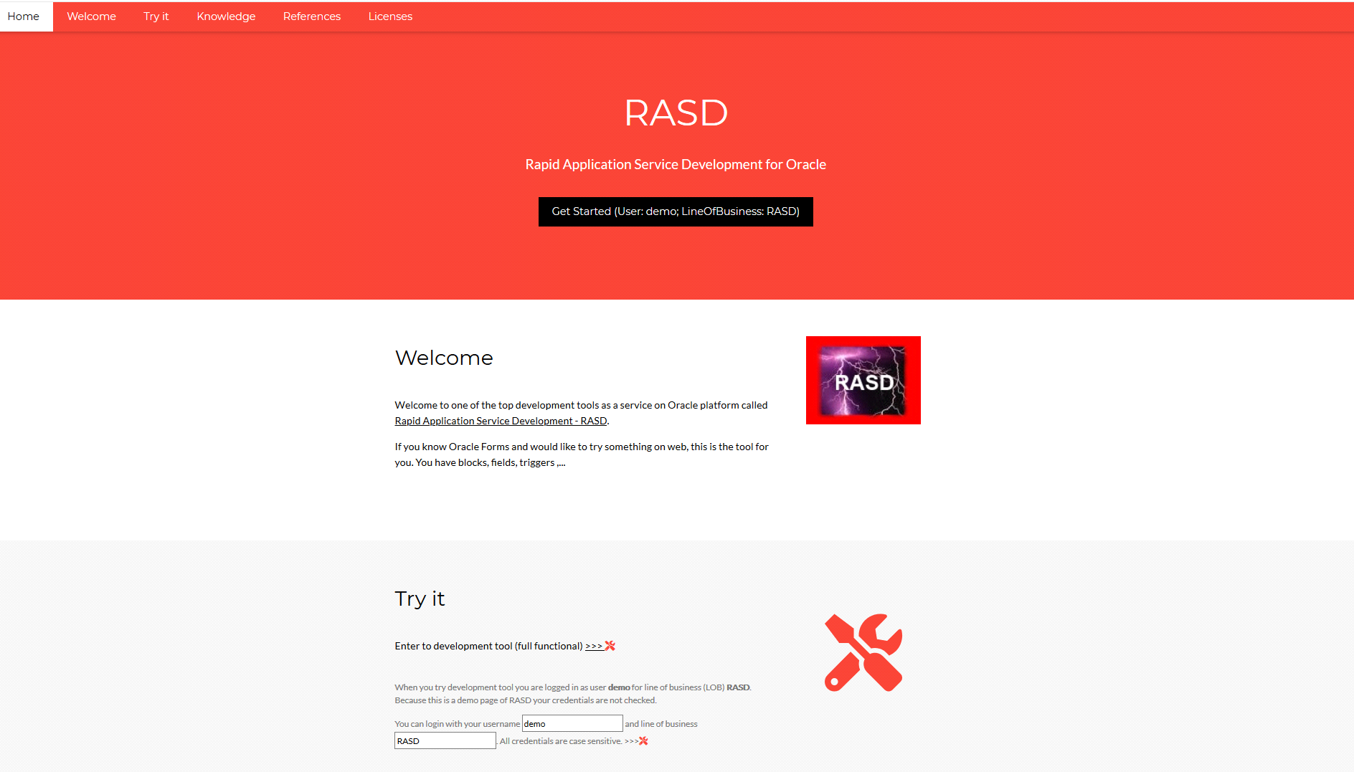

Slide 5
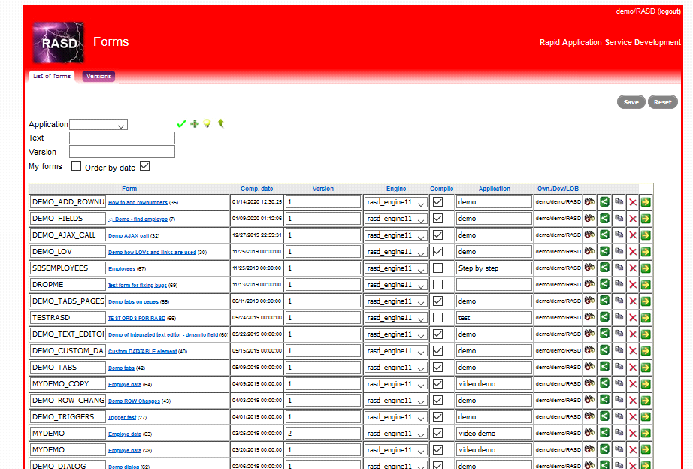
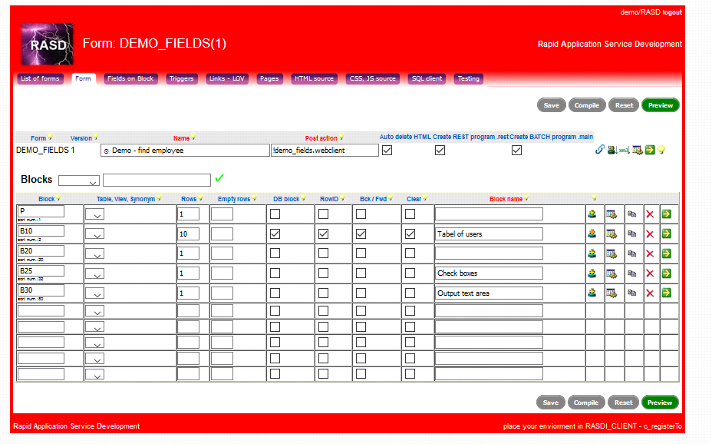
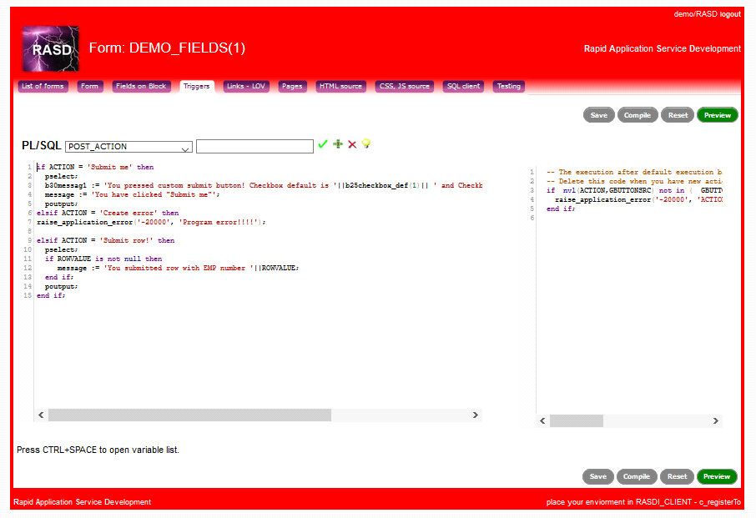

Slide 6
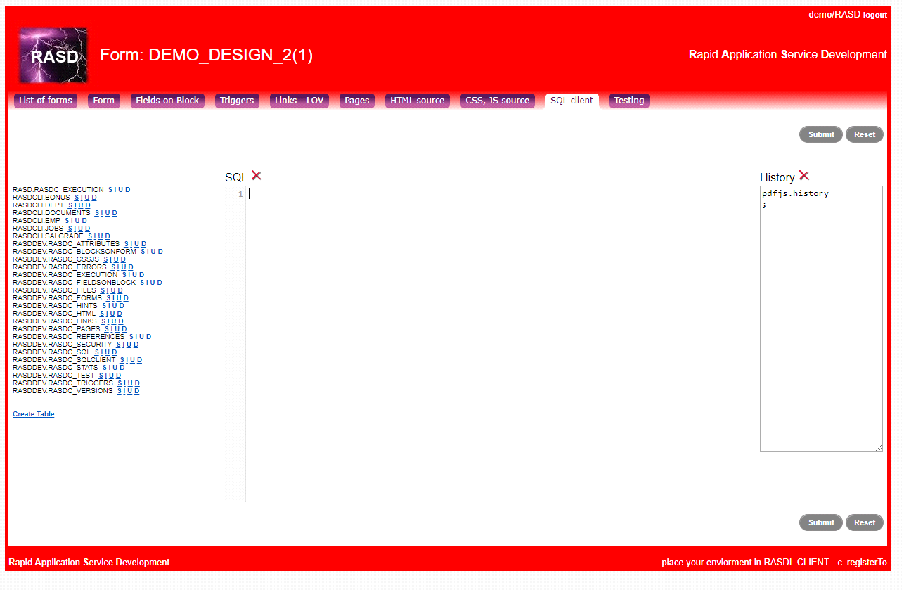
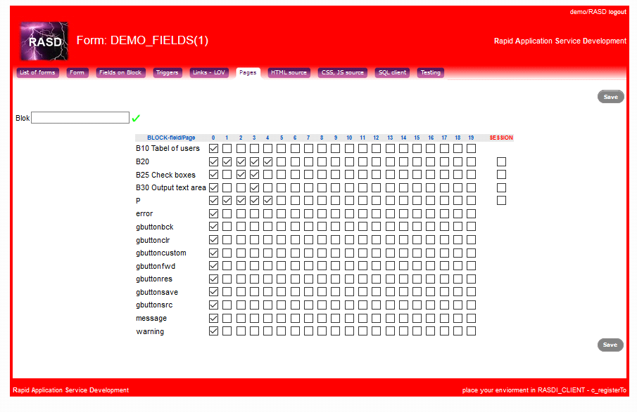
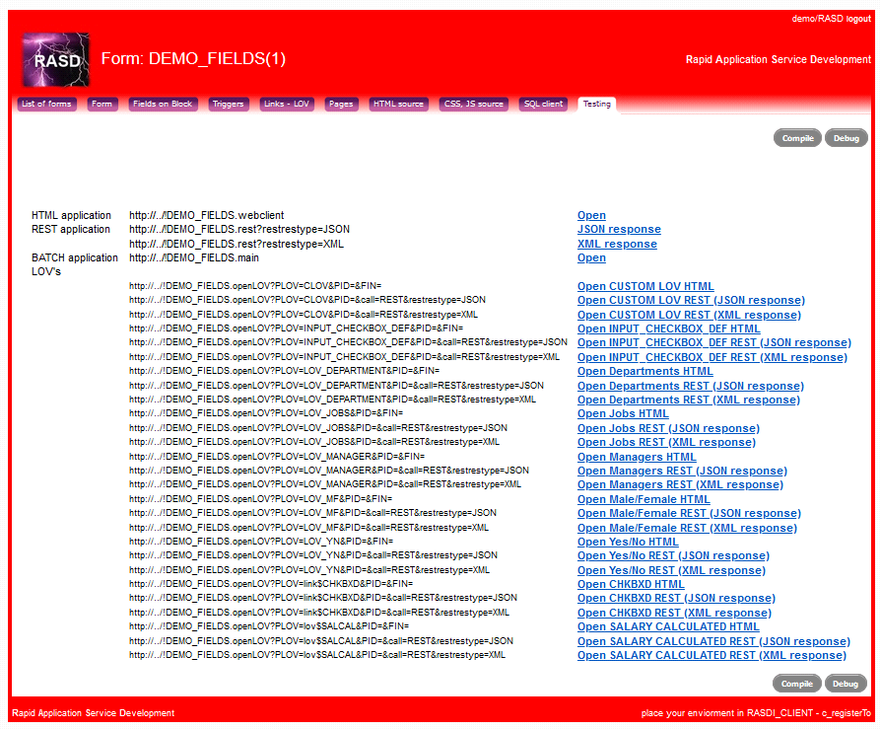

Slide 7
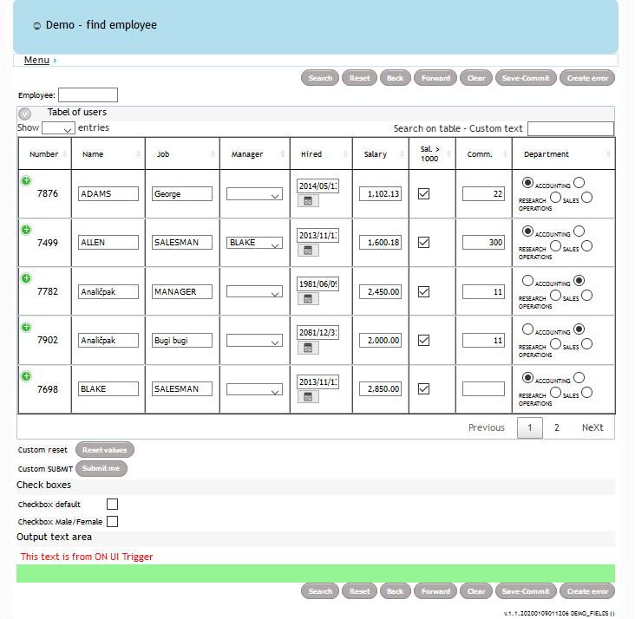
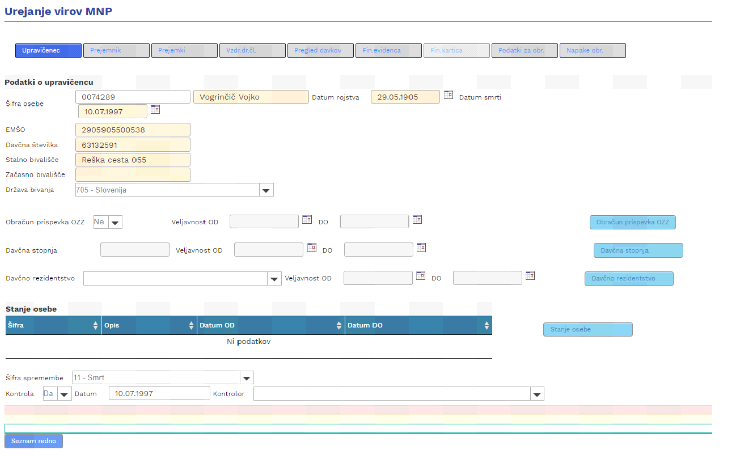

Slide 8
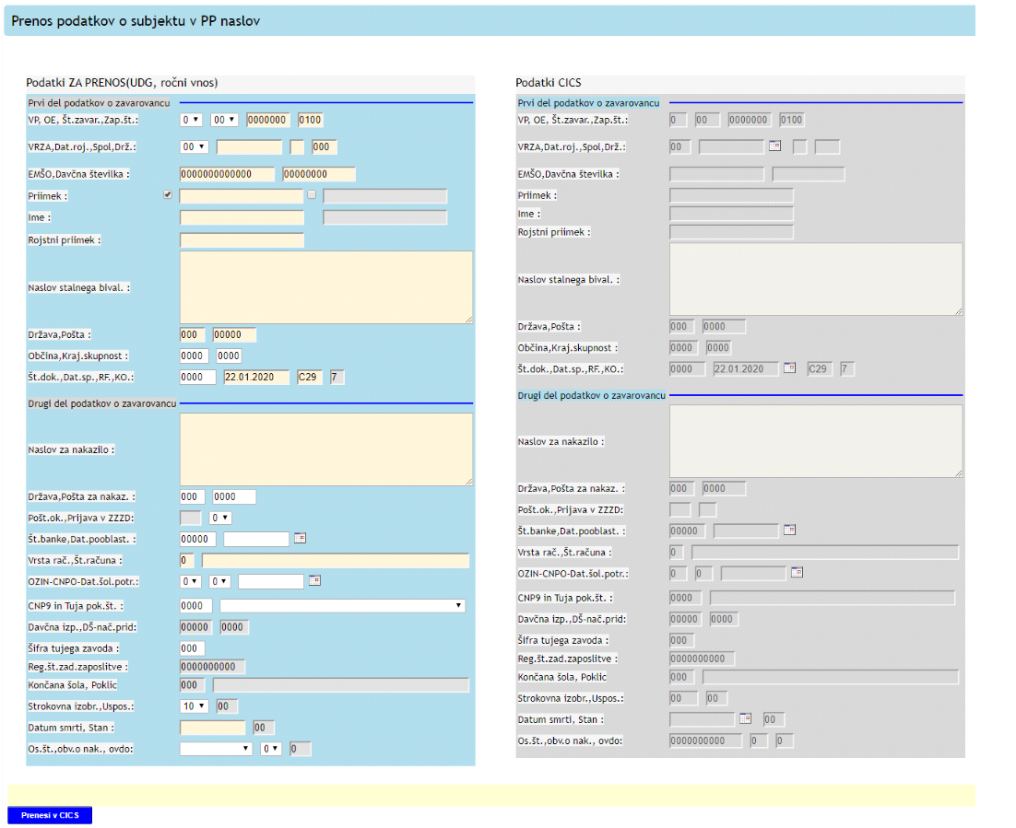
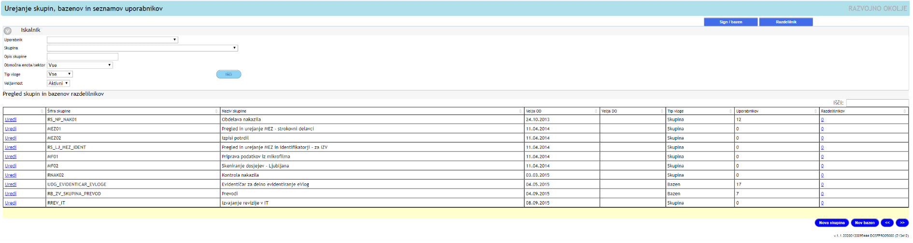

Slide 9
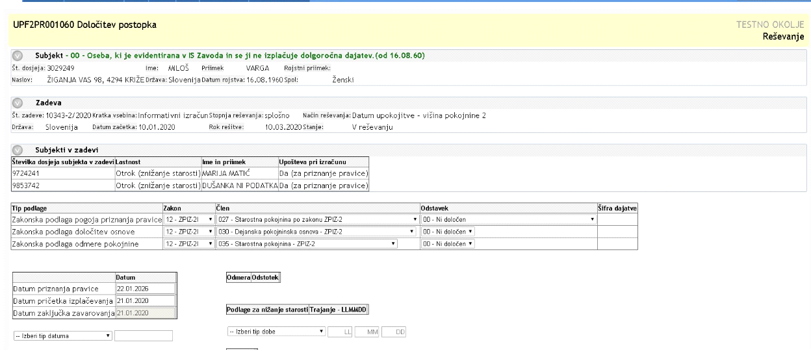
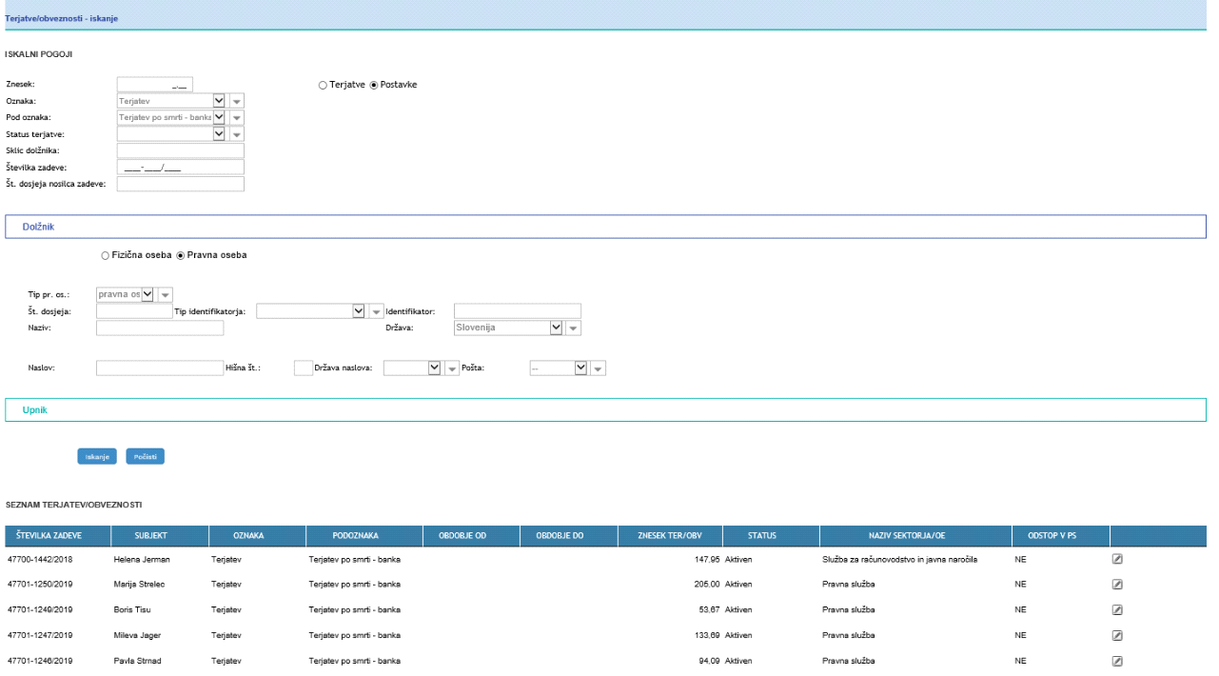
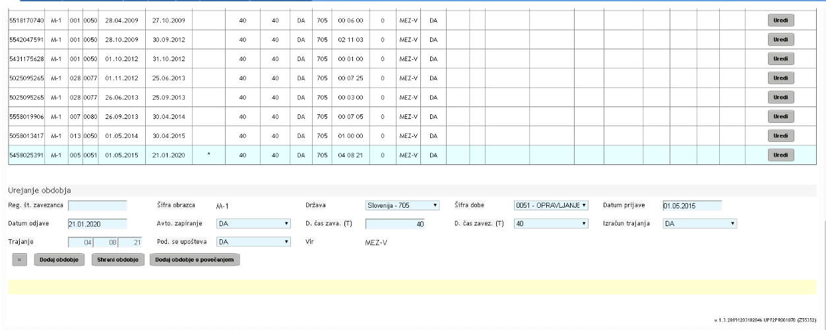

Slide 10
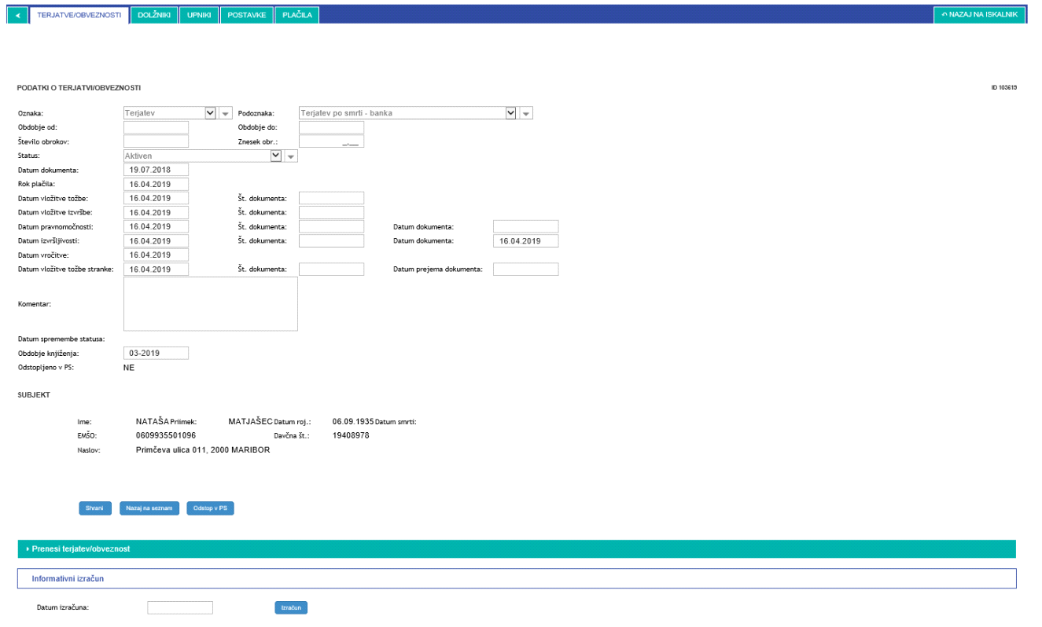
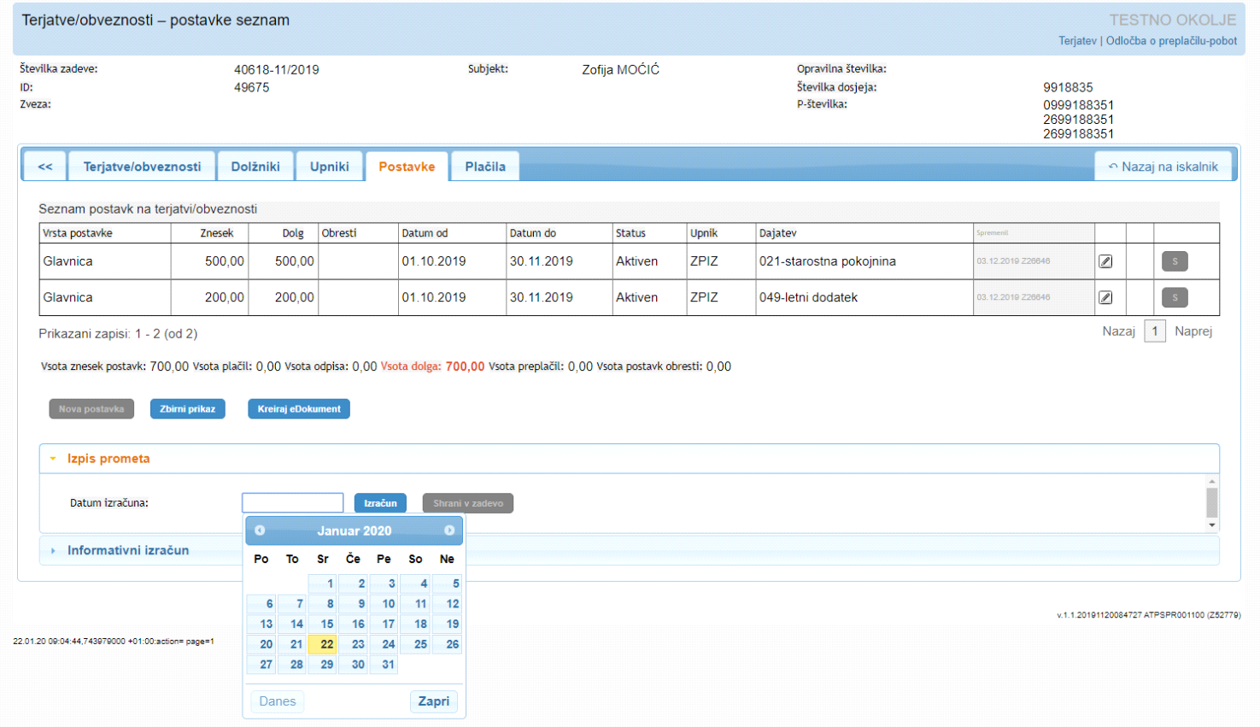

Slide 11
Q&A

